Slide 1
SAP BTP Build Apps Training
Day 7
Anubhav Oberoy
www.AnubhavTrainings.com
Follow excellence with sheer passion

Slide 2


DISCLAIMER
The training content and delivery of this presentation is confidential, and cannot be recorded, or copied and distributed to any third party, without the written consent of Anubhav Trainings

Slide 3
Agenda – Day 7
01
Adding Search
02
Create Cart
03
BPA Introduction

Slide 4
Questions
If each variable is basically the same – they hold data – why use data variables? What are the 3 big advantages for using a data variable?
While all variables hold data, data variables in platforms like AppGyver, FlutterFlow, or similar low-code tools offer some unique advantages:
Three big advantages of data variables:
Automatic binding to data sources:
Data variables are connected directly to your backend or database (e.g., Firebase, REST API). They automatically fetch and update data.
Built-in lifecycle management:
They automatically refresh at certain events (e.g., on page load or when returning to the page), reducing the need for manual logic.
Simplifies UI binding:
You can easily bind a data variable to UI components like lists or text fields without manually parsing data.

Slide 5
Questions
2. What does the main logic for this page do? When is it executed?
The main logic on a page (often found in the "Page Mounted" or "Page Loaded" event) typically does things like:
Fetch data from a data source.
Initialize variables.
Set up UI components or display conditions.
It is executed when the page is first opened or loaded — essentially, it's the first set of actions triggered when the user navigates to that page.

Slide 6
Questions
3. What other types of events can I capture and create logic for?
You can capture and create logic for many types of events, such as:
Page events:
Page mounted (when the page loads)
Page focused (when the user navigates back to the page)
Component events:
Button pressed
Input changed
List item tapped
System events:
App launched
Device orientation changed
Keyboard opened/closed
Custom events:
Events you define and trigger through logic flows

Slide 7
Questions
4. What are the 2 ways you can navigate to a new page?
Two common ways to navigate to a new page are:
Using a "Navigate to Page" flow function (standard navigation)
You specify which page to go to, and it opens it.
Using a "Replace Page" flow function (replaces current page)
This navigates to a new page but removes the current page from history, so the user can’t go back with the back button.

Slide 8




















Slide 9













Slide 10
SAP BTP Build Process Automation
SAP Build Process Automation is a citizen developer solution to adapt, improve, and innovate business processes with no-code workflow management and robotic process automation capabilities.
SAP Build Process Automation enables business users and technologists to become citizen developers. With powerful yet intuitive low-code and no-code capabilities, the solution supports you in driving automation by tapping into the expertise of citizen developers.
Features
Build or adapt processes with an intuitive graphical interface.
Create forms-based workflows using drag-and-drop functionality.
Develop and manage decision logic in tabular, spreadsheet-like decision tables.
Automate repetitive tasks within existing process flows using robotic process automation.
Create intelligent actions and recommendations using machine learning capabilities.
Work efficiently from a unified launchpad and task center.
Hand over projects to professional developers, who can embed actions and advanced workflows into projects initiated by citizen developers.
Support real-time, event-driven transparency into comprehensive processes and process instances with process visibility dashboards.
In addition, SAP Build Process Automation offers prebuilt content and features – such as bots, process steps, business rules, and workflow components.

Slide 11
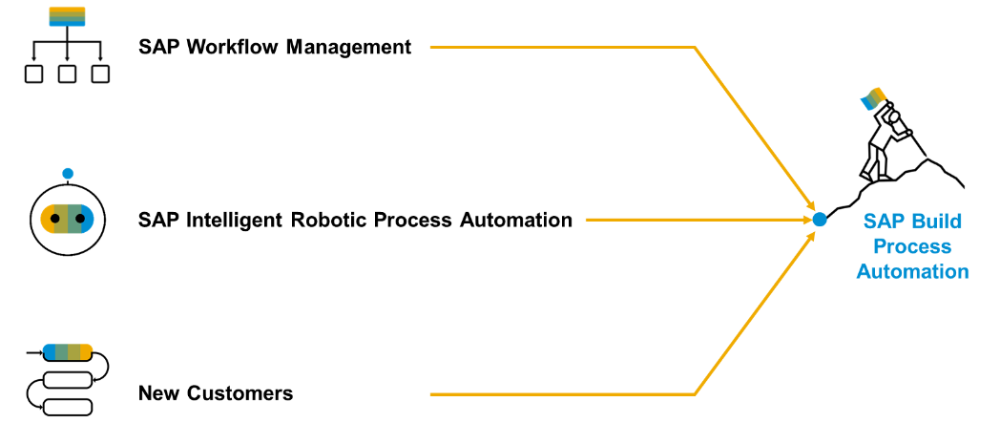
Product Overview
SAP Build Process Automation is a solution that evolved out of the former stand-alone SAP products - SAP Workflow Management and SAP Intelligent Robotic Process Automation. It provides a new citizen developer experience that didn't exist in either of the two former products.
As you or your company might have used SAP Workflow Management or SAP Intelligent Robotic Process Automation in the past, you are looking for a path into the joined solution. Fortunately, SAP Build Process Automation is fully compatible with all workflow and automation artifacts that you have created.

Slide 12
Deploy the BPA process
Design time object
process
Runtime object
process
deploy
We can check the control tower > environment,> process > triggers when open the same we can find the API and the context.

Slide 13


Scenario
Build Process Automation
BTP
Sales Order
(Build Apps)
approval
<data>
app
rej
Manager
<data>
Sales Representative
Build workzone
My Inbox
S/4HANA

Slide 14
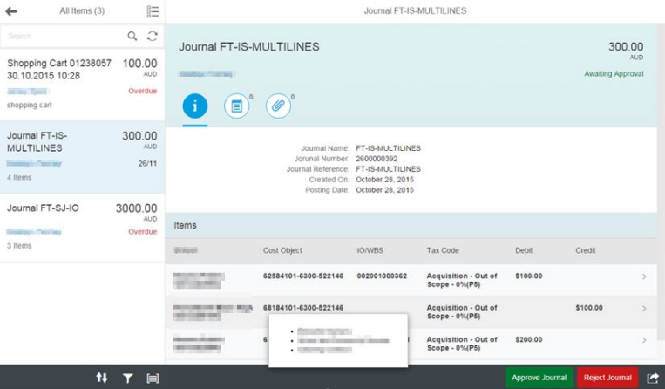
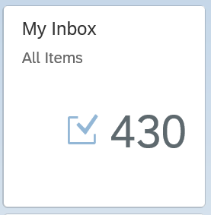
My Inbox Fiori App
In SAP Business Technology Platform (BTP), the Inbox Fiori app typically refers to an application that provides a centralized view for managing tasks and notifications within the system. This app allows users to handle workflow tasks and process approvals directly from within the Fiori interface.
Here are some key points about the Inbox Fiori app:
1. Task Management: It provides an interface where users can view, manage, and act upon their tasks. These tasks can be related to business workflows, approvals, or notifications that need attention.
2. Integration with SAP Workflow: The Inbox app is often integrated with SAP Business Workflow, allowing users to interact with tasks that are part of larger business processes.
3. User-Friendly Interface: As part of the Fiori design principles, the app offers a simple, intuitive, and responsive user interface that can be accessed on desktop and mobile devices.
4. Real-Time Updates: Users are notified of new tasks, and updates to tasks are reflected in real-time, ensuring that users can stay on top of their workload.
6. Access Control: Only users with appropriate roles and permissions can access specific tasks, ensuring that the right people are notified and able to act on the tasks.

Slide 15
The destination sap_process_automation_service
https://help.sap.com/docs/build-process-automation/sap-build-process-automation/configure-sap-build-process-automation-destinations

Slide 16

What We Did
Let’s Summarize

Slide 17

www.anubhavtrainings.com
Thank You
End of Day 7

Slide 18


We’re committed to empower you to be
#FutureReady
through powerful training solutions.
We build the workforce of the future.
250+
Corporate Clients
30,000+
Learners Trained
25000+
Learners Placed
FREE WEBINARS
Sign up for free webinars with industry experts every fortnight!
Enroll Now!
Contact us today!
https://anubhavtrainings.com

